Slide 1

Functionalities in MySQL
Hitha Choudhary - 22BTRAD015

Slide 2

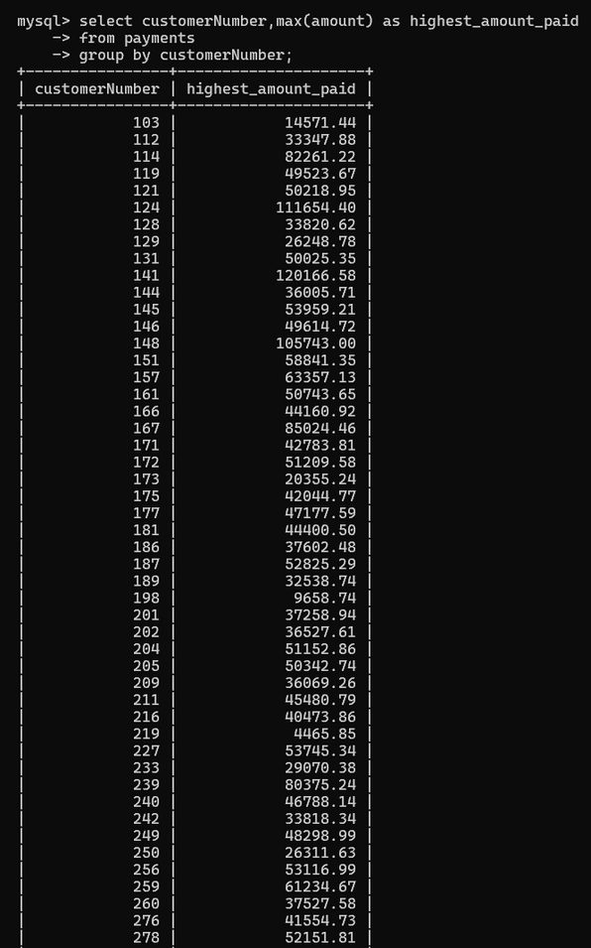
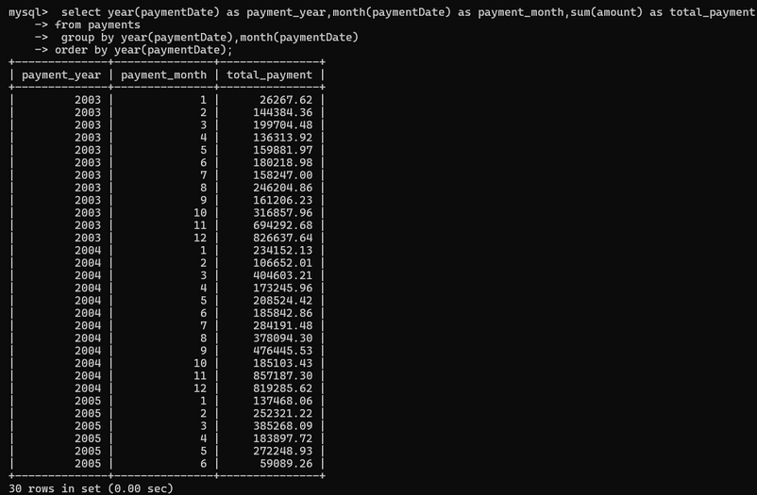
Group by
It divides the data into groups by the values in the column specified, and returns one row of results for each group.
Often used with aggregate functions(count, sum, avg etc.,)
Multi columns Group by
List the column names separated with commas.
Rows are grouped only if all the values in the specified columns are identical across the specified rows.

Slide 3
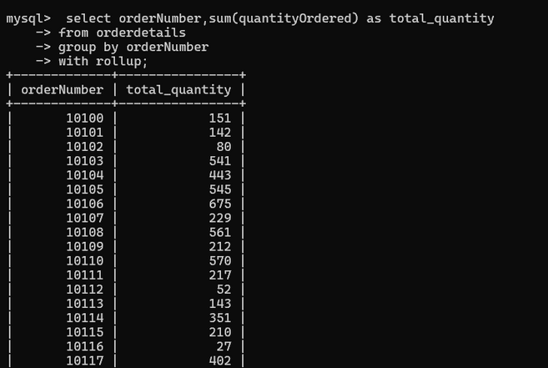
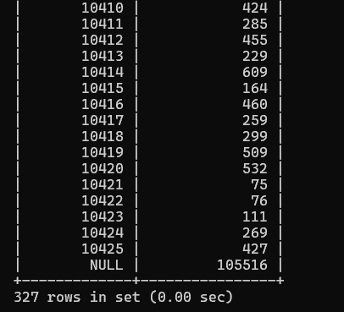

Group by with Rollup Modifier
Includes summary output extra rows that indicate higher-level summary operations.
Calculates the summaries at different levels of grouping specified in the GROUP BY clause.
Applications
Sales analysis : Grouping by products across different categories to compare and analyze the highest selling products across the categories.
Social Media Engagement: Grouping by user activity to understand the peak hours and schedule content posting for more engagement.

Slide 4
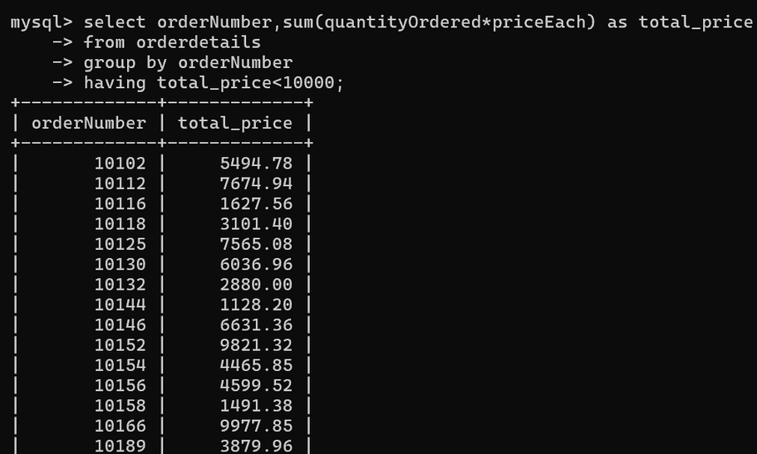
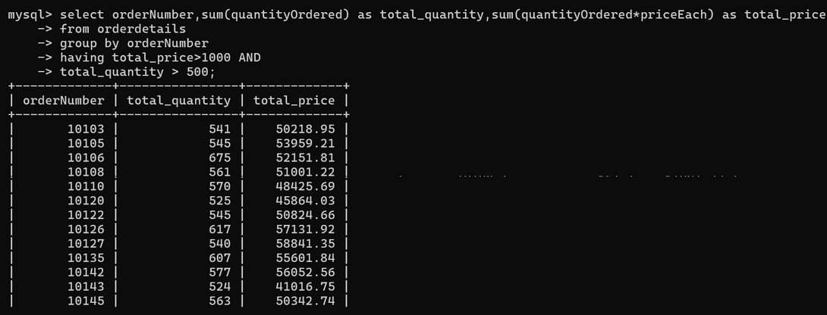
Having
It is used in conjunction with the Group By clause to filter the groups based on a specified condition.
Allows us to apply a condition to the groups returned by the Group By clause and only include groups that meet the specified condition.
Having with logical operators
Logical operators can be used to create more complex filtering criteria.
AND: Filters groups where both conditions using logical operators are true for the aggregate values, OR: Filters groups where at least one of the conditions using logical operators is true for the aggregate values.

Slide 5
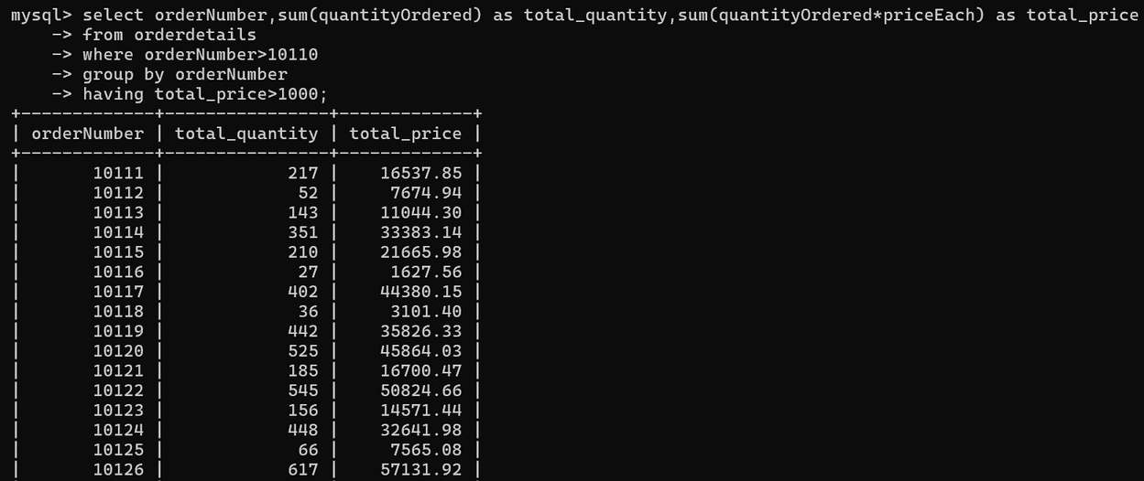
Having vs Where
Where clause filters individual rows; Having clause filters groups instead of one row at a time.
Since Where clause is only useful for filtering individual rows, it cannot be used with aggregate functions. Having can be used with aggregate functions because it filters groups.
Applications
Reporting: Useful for generating reports based on only certain conditions.
Event Management: Can be used to analyze and filter out events based on the number of attendees.

Slide 6
THANK YOU
https://github.com/hithachoudhary/internship-phase-2-daily-logs

